Slide 1
Unit6
The RGB color model in Computer Graphics

Slide 2
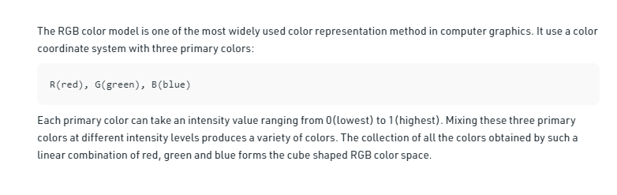

Slide 3
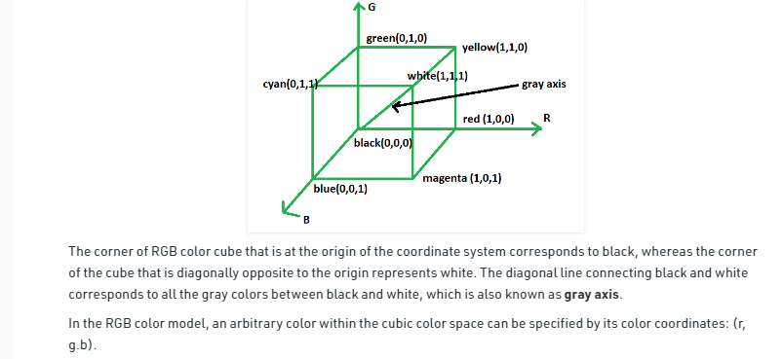

Slide 4
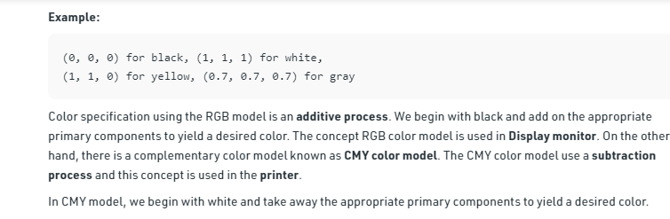

Slide 5
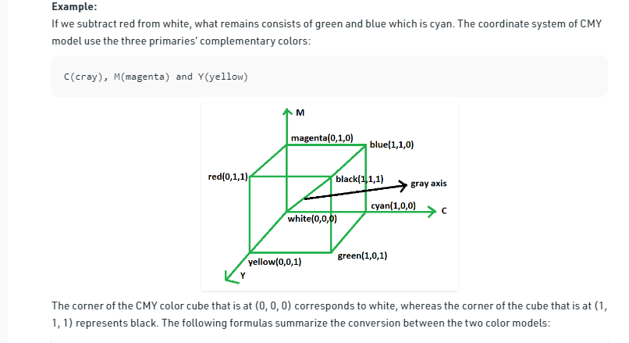

Slide 6
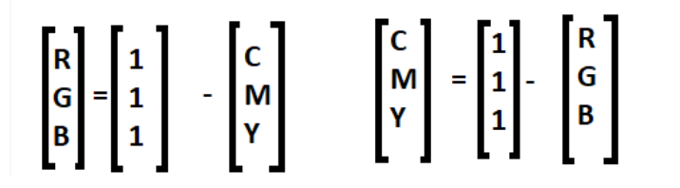

Slide 7
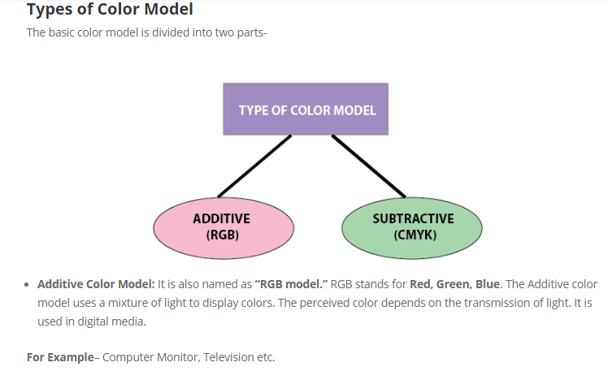

Slide 8
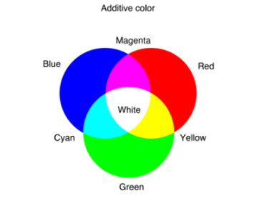

Slide 9
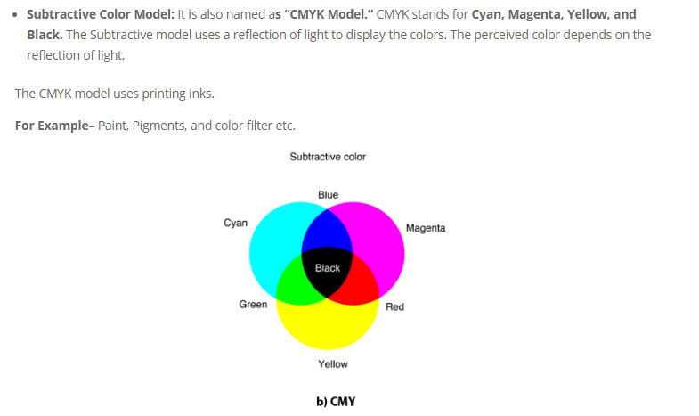

Slide 10
RGB color scheme is an additive type mode that combines the colors:- red, green, and blue, in various degrees which creates a variety of different colors.
When all three colors are combined and displayed to the fullest degree, the combination gives us white color, for example for white combination will be RGB (255, 255, 255).

Slide 11
When all three colors are combined to their lowest degree or value, the result is black, for example for black combination is RGB (0, 0, 0).
RGB color Scheme offers the widest range of colors and hence preferred in many computer softwares.

Slide 12
Uses of RGB Color Scheme –
Used when project involves digital screens like computers, mobile, TV etc.
Used in web and application design.
Used in online branding.
Used in social media.

Slide 13
CMYK color scheme is a subtractive type mode that combines the colors:- cyan, magenta, yellow and black in various degrees which creates a variety of different colors.
A printing machine creates images by combining these colors with physical ink.

Slide 14
Uses of CMYK Color scheme –
Used when project involves physically printed designs etc.
Used in physical branding like business cards etc.
Used in advertising like posters, billboards, flyers etc.
Used in cloth branding like t-shirts etc.

Slide 15
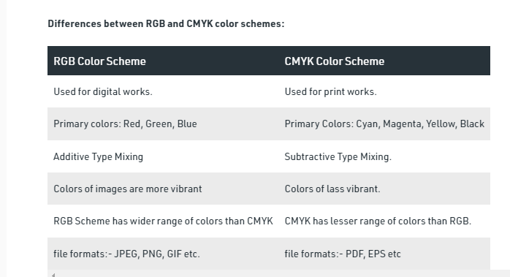

Slide 16
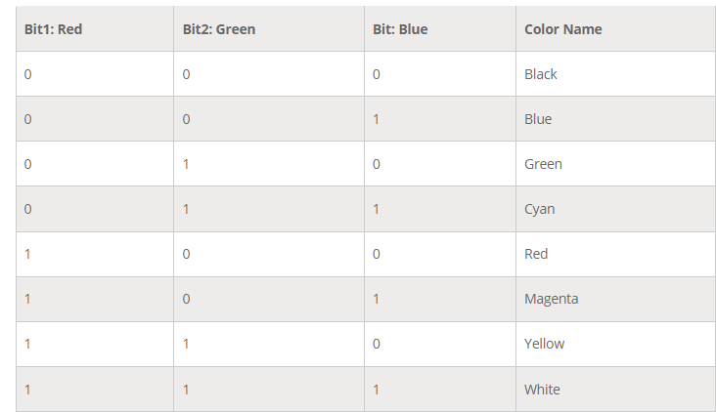
Color table in RGB

Slide 17
Mostly 3 bytes, or 24 bits per pixel are used in industries and companies.
with 1 byte for each primary color.
We can allot each primary color to have 256 different intensity levels, similar to binary values from 00000000 to 11111111.

Slide 18
The color of the pixel can be 256 x 256 x 256 or 16.7 million.
The representation of black and white, the grayscale image, needs just 1 bit per pixel.
The bit value 0 represents black, and 1 represents white.

Slide 19
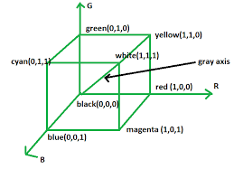
Direct Coding is a technique or process which is used to provide a certain amount of memory storage space for a pixel to encode the pixel with the color.
For Example– If we assign one bit for each primary color to 3-bit for each pixel. This 3-bit representation allows the two intensity levels of each primary to separate: 0(Off) or 1(On),then each pixel can occupy one color out of eight colors that are similar to the corner of the RGB color cube as shown in above table.

Slide 20
The direct coding technique is simple, and it also supports various applications.

Slide 21
HSV color model

Slide 22
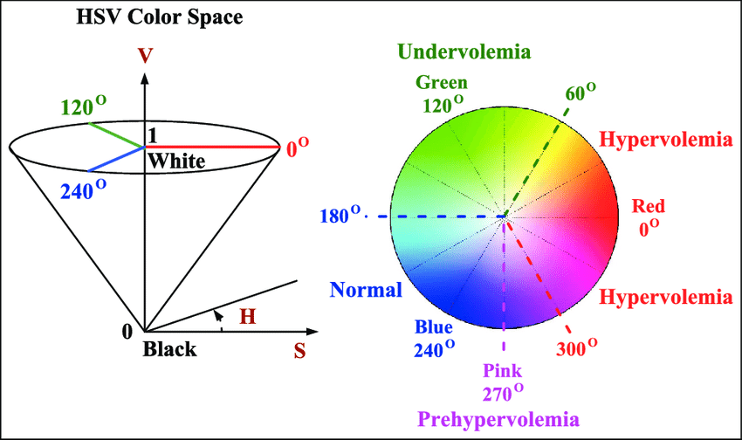
HSV color model
HSV stands for Hue, Saturation, and Value

Slide 23
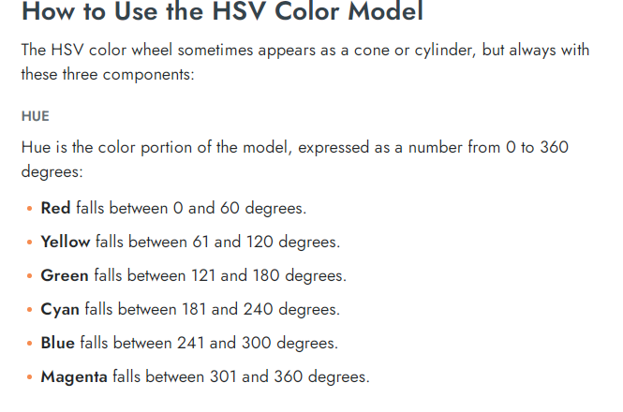

Slide 24
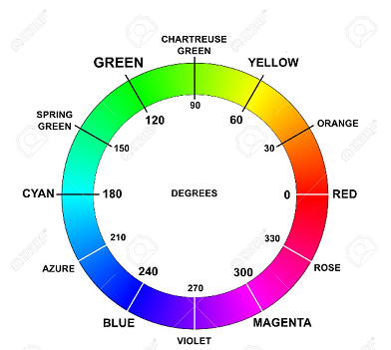

Slide 25
What is hue?
Hues are the three primary colors (red, blue, and yellow) and the three secondary colors (orange, green, and violet) that appear in the color wheel or color circle.
When we refer to hue, we are referring to pure color, or the visible spectrum of basic colors that can be seen in a rainbow.

Slide 26
What is saturation?
Color saturation is the purity and intensity of a color as displayed in an image.
The higher the saturation of a color, the more vivid and intense it is.
The lower a color’s saturation,
the closer it is to pure gray on the grayscale.

Slide 27
What Is Color Value?
Color value refers to the relative lightness or darkness of a color.
We perceive color value based on the quantity of light reflected off of a surface and absorbed by the human eye.
We refer to the intensity of the light that reaches the eye as “luminance.”

Slide 28
HSV cylindrical color model remaps the RGB primary colors into dimensions that are easier for humans to understand.
Hue specifies the angle of the color on the RGB color circle.
A 0° hue results in red, 120° results in green, and 240° results in blue.
Saturation controls the amount of color used. A color with 100% saturation will be the purest color possible, while 0% saturation yields grayscale.
Value controls the brightness of the color.
A color with 0% brightness is pure black while a color with 100% brightness has no black mixed into the color.
Because this dimension is often referred to as brightness, the HSV color model is sometimes called HSB

Slide 29
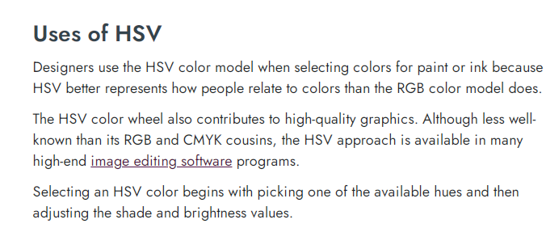

Slide 30
Hue, Saturation, and Value Aspects of Color can Affect our Photography.
Adjusting the hue, saturation, and value can greatly impact the overall composition of our images.
Even the smallest adjustment can affect the way our photograph is perceived by the viewer.

Slide 31
Interactive demo of HSV
https://programmingdesignsystems.com/color/color-models-and-color-spaces/index.html

